Slide 1
1. The Senses and Multisensory Learning
The Importance of Multisensory Learning
www.multisensorylearning.lgfl.net ©2018 www.hirstwood.com & London Grid for Learning

Slide 2
What is Multisensory Learning?
Often we teach through just one sense such as vision (reading text) or sound (listening to instruction).
www.multisensorylearning.lgfl.net ©2018 www.hirstwood.com & London Grid for Learning

Slide 3
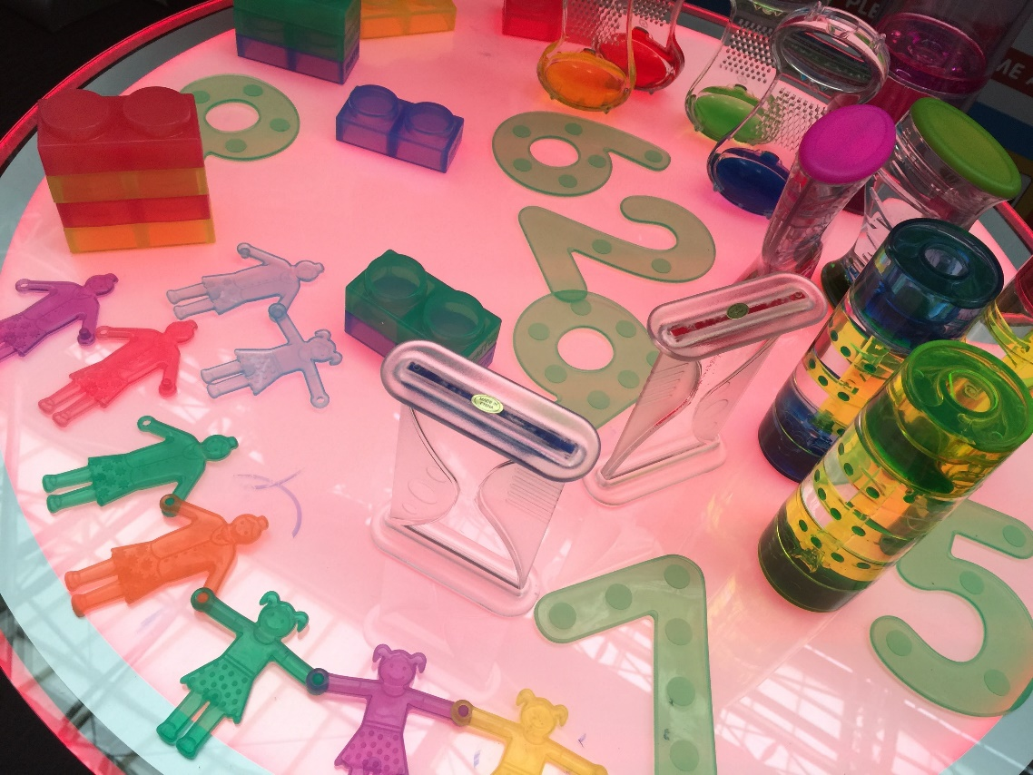
What is Multisensory Learning?
Multisensory learning teaches using more than one sense at a time
It involves using at least two, if not more, different sensory stimuli in a learning activity
www.multisensorylearning.lgfl.net ©2018 www.hirstwood.com & London Grid for Learning

Slide 4
How Does Multisensory Learning Help?
Multisensory learning supports a learner to maintain and develop their sensory skills.
For example, visual stimulation keeps the part of the brain which processes visual information working. With no visual stimulation, the brain might lose the ability to process the visual information it receives.
www.multisensorylearning.lgfl.net ©2018 www.hirstwood.com & London Grid for Learning

Slide 5
How Does Multisensory Learning Help?
Multisensory learning gives learners more than one way to learn a new skill or develop understanding and every child a chance to succeed.
www.multisensorylearning.lgfl.net ©2018 www.hirstwood.com & London Grid for Learning

Slide 6
How Does Multisensory Learning Help?
It teaches them through multiple senses so enriches their understanding
Multisensory teaching supports all children in a class no matter how they learn.
www.multisensorylearning.lgfl.net ©2018 www.hirstwood.com & London Grid for Learning

Slide 7
Who does Multisensory Learning Benefit?
Multisensory learning can be helpful for all learners.
It can be especially supportive for a range of learners with SEND including those with speech, language and communication issues, attention and many learning difficulties.
www.multisensorylearning.lgfl.net ©2018 www.hirstwood.com & London Grid for Learning

Slide 8
Who does Multisensory Learning Benefit?
These learners may find it more difficult to process information through only reading (visual) or listening (audio).
Using multisensory learning can help them collect information, problem solve and make connections.
www.multisensorylearning.lgfl.net ©2018 www.hirstwood.com & London Grid for Learning

Slide 9
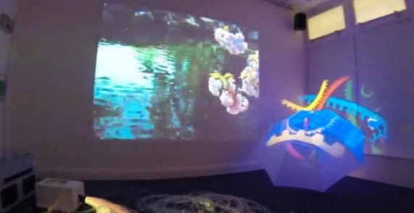
Multisensory Learning: An Example
For example, a class might be learning about Life Under the Sea.
If they were learning through a single sense, they might just be looking at pictures of different sea creatures or hearing about them.
www.multisensorylearning.lgfl.net ©2018 www.hirstwood.com & London Grid for Learning

Slide 10
Multisensory Learning: An Example
Multisensory learning of this topic might give them an opportunity to hear the waves or sea creatures, feel the water or sand or even see what life could be like under the sea using a sensory tent or umbrella and projection.
Their learning experience would be much fuller and more enriching, particularly for learners with SEND
www.multisensorylearning.lgfl.net ©2018 www.hirstwood.com & London Grid for Learning

Slide 11
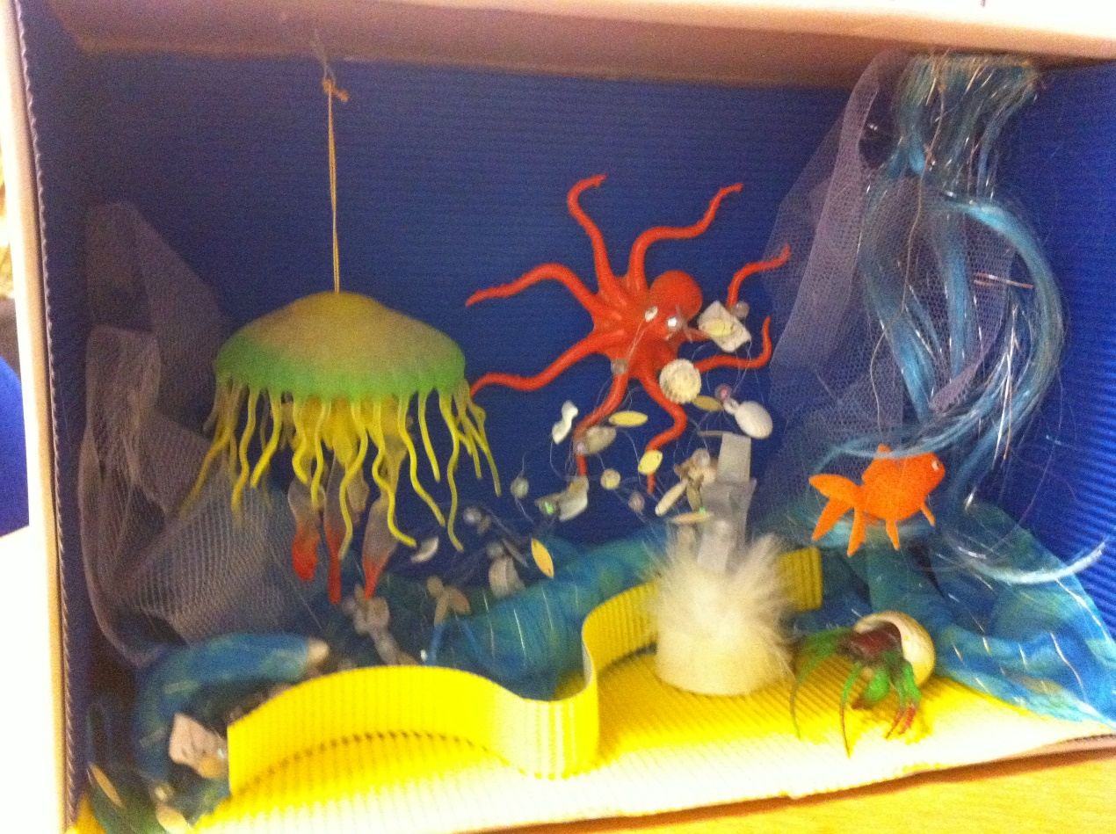
Modifying Multisensory Stimulus
Multisensory learning can help individuals learn through their learning and sensory strengths.
It is important to offer specific sensory stimulation activities which suit a learner’s sensory skills and needs.
www.multisensorylearning.lgfl.net ©2018 www.hirstwood.com & London Grid for Learning

Slide 12
Modifying Multisensory Stimulus
For example, for a learner with good physical hand skills, but poor hearing, we can use vibration from a speaker inside a car wash mitt, to make sound more accessible and meaningful. In this activity, the learner’s tactile and hearing senses are being encouraged to develop and work together.
www.multisensorylearning.lgfl.net ©2018 www.hirstwood.com & London Grid for Learning

Slide 13
Developing a Multisensory Curriculum
For more information on developing a multisensory curriculum, supporting learners with particular SEND, utilising helpful equipment and modifying your environment, go to further sections in www.multisensory.lgfl.net and other relevant content such as www.movementforlearning.lgfl.net .
www.multisensorylearning.lgfl.net ©2018 www.hirstwood.com & London Grid for Learning

